Slide 1
How does temperature impact carbon sequestration?
Notes:
Ask students for input and predictions (not necessarily hypotheses yet)

Slide 2
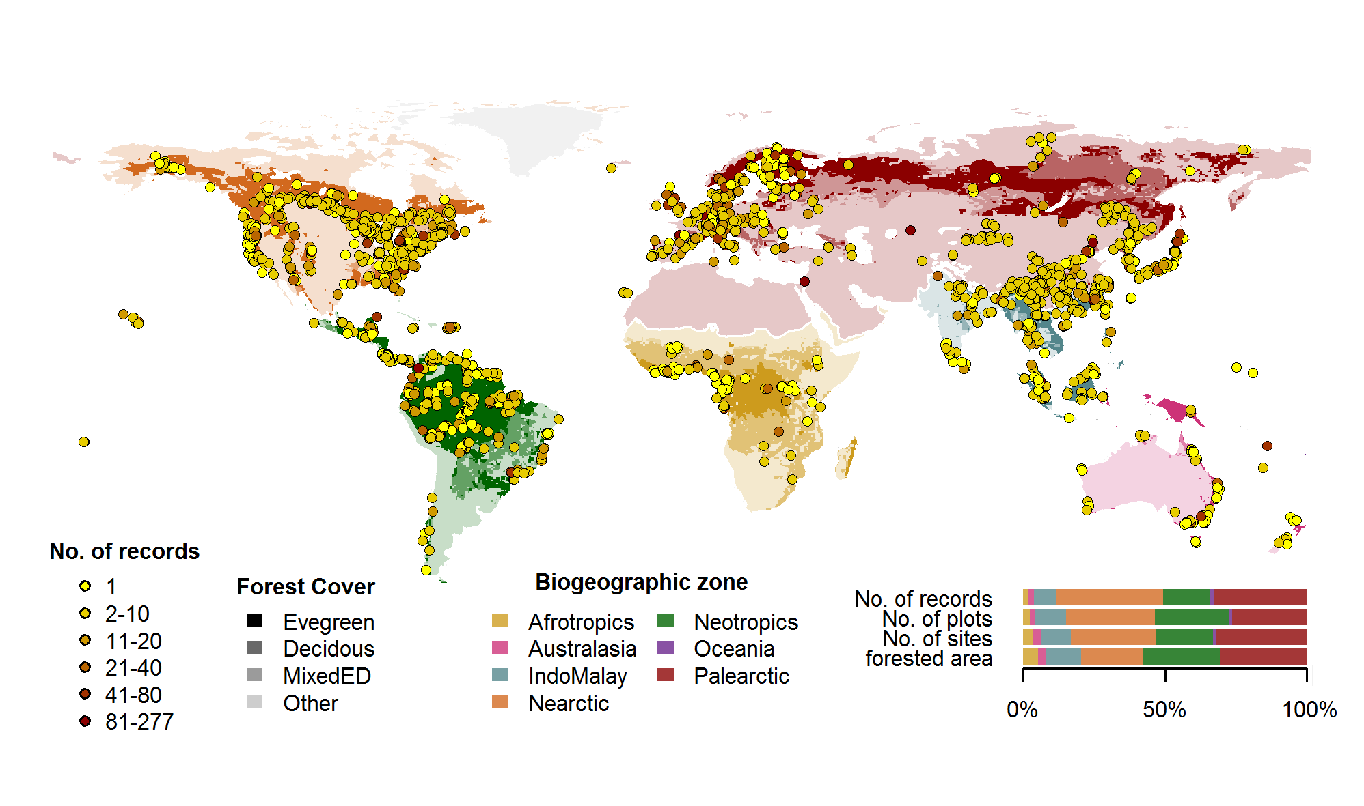
ForC Records
Notes:
This contains the ForC databases from around the world. Students will be working with data from 102 different locations

Slide 3
A Year in the Life of Earth’s CO2
Before the video begins predict what will happen to Earth’s carbon dioxide concentrations over the course of a year.
What happens to the carbon dioxide emitted from fossil fuel combustion? Where does it go?
Watch the video carefully and write down quick notes on what you’re seeing as the year progresses. Note months with high and low concentrations. Write down as many observations as you can. Be sure to write down any major changes or anything you hear that is surprising.
What is happening to the concentrations of carbon dioxide in the air?
Notes:
https://svs.gsfc.nasa.gov/cgi-bin/details.cgi?aid=11719

Slide 4
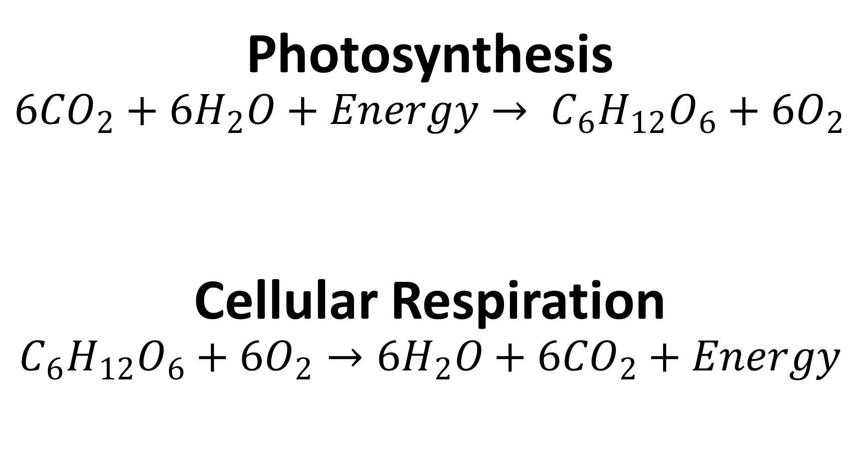
Photosynthesis
$$6{CO}_{2}+{6H}_{2}O+Energy→ C_{6}H_{12}O_{6}+6O_{2}$$
Cellular Respiration
$$C_{6}H_{12}O_{6}+6O_{2}→{6H}_{2}O+6{CO}_{2}+Energy$$
Notes:
Review the formulas for photosynthesis and cellular respiration, make sure to discuss their connections

Slide 5
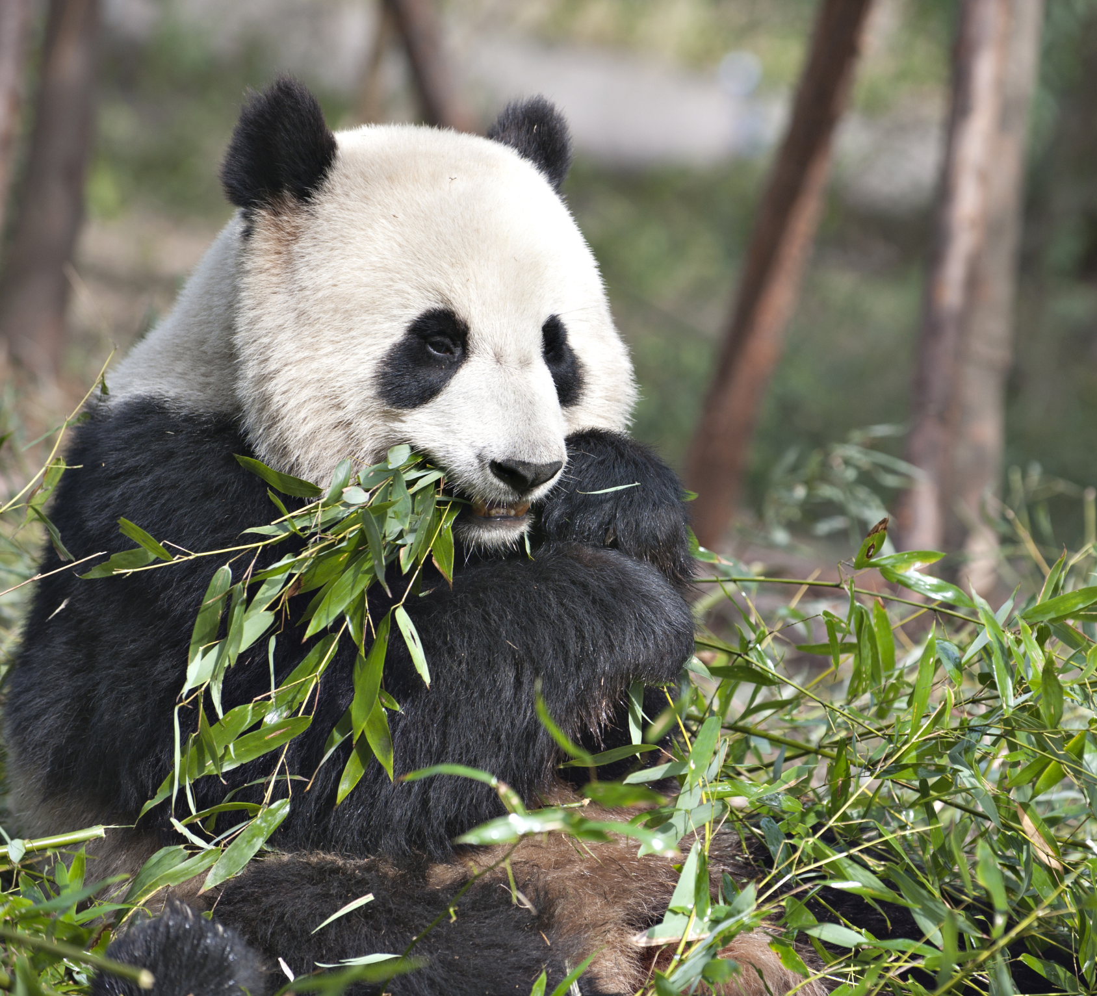
Biological Carbon Cycle
Carbon enters all food webs, both terrestrial and aquatic, through autotrophs (usually through photosynthesis)
Heterotrophs consume the organic molecules, and the organic carbon is passed through food chains and webs.
Carbon is released back into the atmosphere through cellular respiration
Producers, Consumers, Decomposers
Notes:
Carbon can cycle quickly through this biological pathway, especially in aquatic ecosystems. Overall, an estimated 1,000 to 100,000 million metric tons of carbon move through the biological pathway each year. For context, a metric ton is about the weight of an elephant or a small car

Slide 6
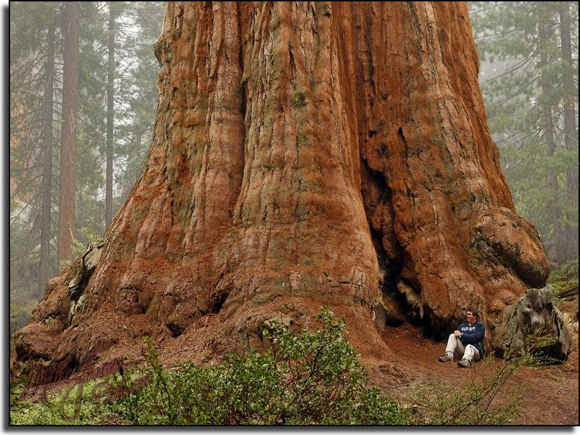
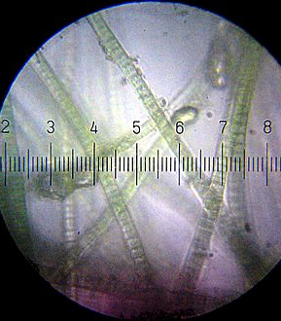
Carbon fixation: the conversion of inorganic carbon (carbon dioxide) to organic compounds by living organisms
Carbon sequestration: a natural or artificial process where carbon dioxide is removed from the atmosphere and held in solid or liquid form.
Notes:
The basic difference between fixation and sequestration

Slide 7
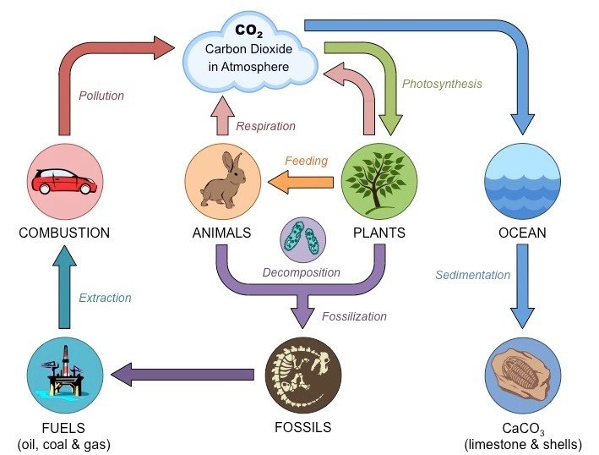
Notes:
Ask for input on the carbon cycle, review the basic process of global warming (where Carbon Dioxide in the atmosphere traps heat causing the global temperature to rise), you may use the handout instead

Slide 8
Notes:
This shows fluctuations in carbon stocks. Note that most carbon is cycled through the forest and a small percentage overall is actually put into the forest sink. A negative number means carbon is being pulled from the atmosphere and a positive number means it’s being released.

Slide 9
ForC: The Forest Carbon database
ForC is an open-access database containing over 29,713 records from 4,971 plots in 3,325 geographically distinct areas.
All data in ForC comes from published research by accredited scientists.
This database covers all forested biogeographic and climate zones
ForC can be used for ecological analysis of forest carbon cycling, evaluating models and remote sensing, and supporting international efforst to inventory forest carbon and greenhouse gas exchange.

Slide 10

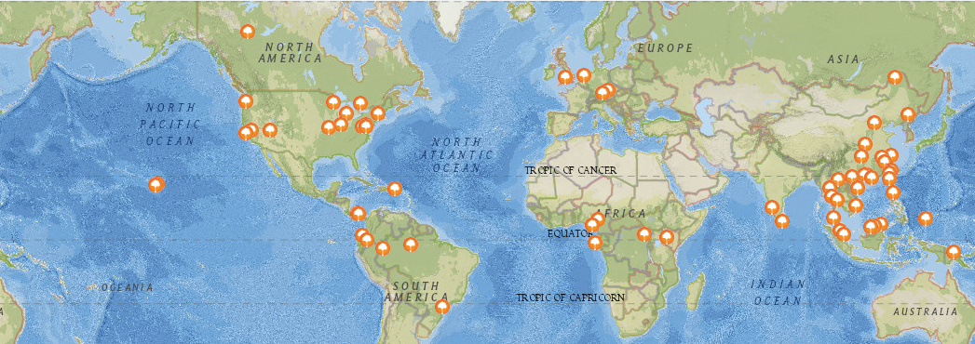
The Forest Global Earth Observatory (ForestGEO), previously known as Center for Tropical Forest Science (CTFS), is a global network of forest research sites and scientists dedicated to the study of tropical and temperate forest function and diversity.
The multi-institutional network comprises 66 forest research sites across the Americas, Africa, Asia, Europe, and Oceania
ForestGEO monitors the growth and survival of approximately 6 million trees and nearly 13,000 species that occur in the forest research sites.
A map of all ForestGEO sites
Notes:
https://forestgeo.si.edu/. Information on ForestGEO

Slide 11
The Process of Science
1 Question
2 Research
3 Hypothesis
4 Develop protocols
5 Collect Data
6 Process Data
7 Analyze Data
8 Conclusion
Notes:
We have now progressed from 1, to 2, and are moving into 3. Steps 4 and 5 were done for us by researchers around the world. We will skip those steps and move onto 6, 7, and 8.

Slide 12
Getting Ready for the analysis: Explore the Data
https://forc-db.github.io/
Notes:
Give students some time to think, pair, share or work in small groups to write down notes (time them). Then call on students to contribute to give you some important points to write down.

Slide 13
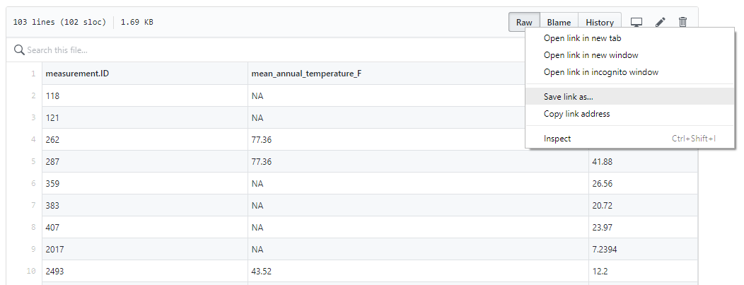
Download the Dataset: https://github.com/forc-db/ForC/blob/master/educational%20resources/ForC_GPP_and_temperature.csv
NOTE! Since ForC is often updated with new data your data might look different than the PPT, but your final graph should look similar
Notes:
(https://github.com/forc-db/ForC/blob/master/educational%20resources/ForC_GPP_and_temperature.csv)

Slide 14
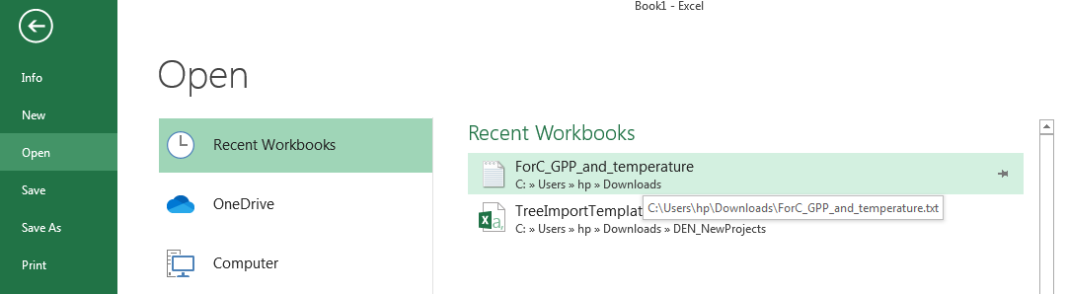
Import the data into Excel
Your data will automatically be saved as a text document
Load Excel and create a blank workbook
Click File and Open, find the downloaded text file (ForC_GPP_and_temperature), and click it

Slide 15
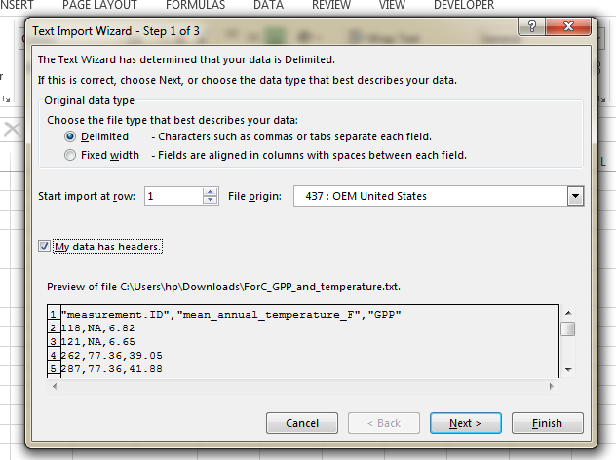
Fill out the Text Import Wizard
On step 1 of 3 , make sure Deliminated and My data has headers are both selected
Then click Next >

Slide 16
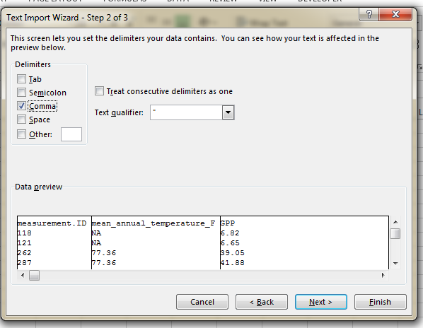
Fill out the Text Import Wizard
On step 2 of 3 click Comma and then Finish

Slide 17
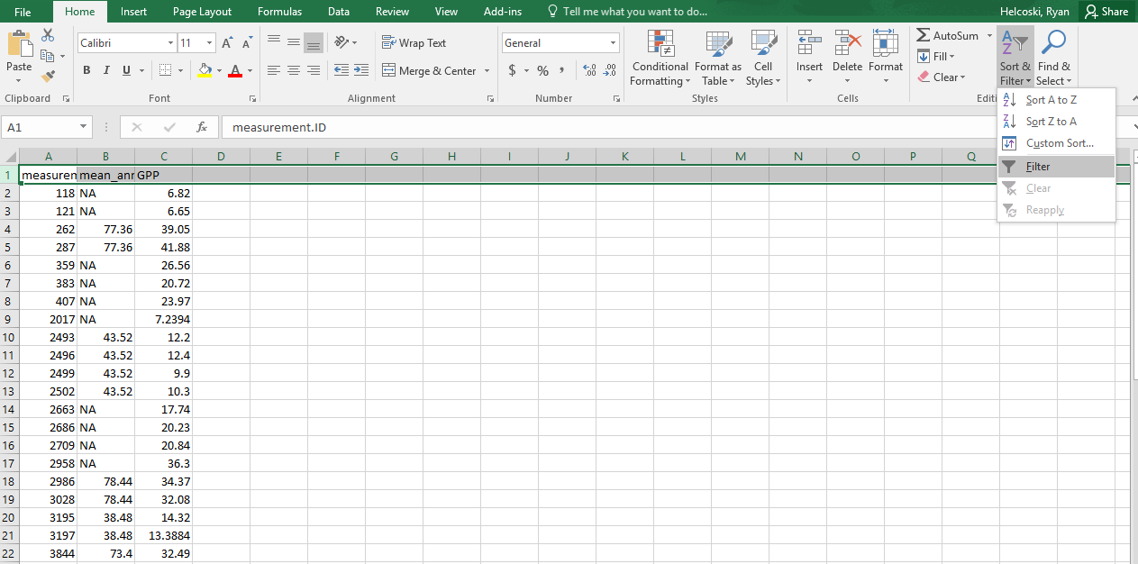
Create Filters

Slide 18
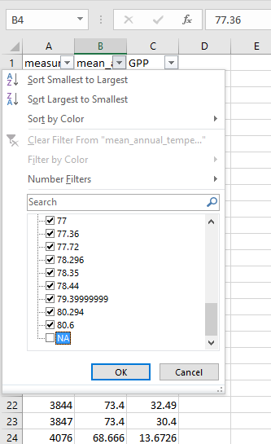
Search the columns
Search each column for any “NA” , “NAN” or similar values that indicate missing data.
Click the down arrow tap to open the drop box and then just click off the check mark in the appropriate box to remove the values.

Slide 19
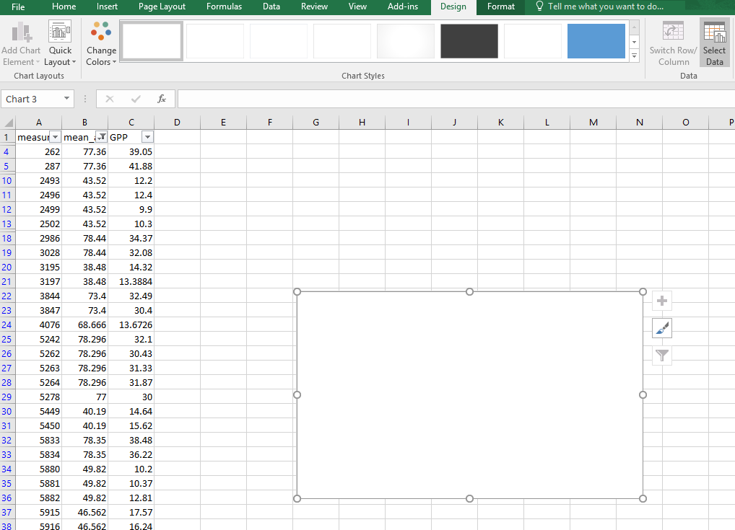
Create a Scatter Plot
Click the Insert tab
Then click Scatter and the first option
A black box should appear

Slide 20
Create a Scatter Plot
Next click the “select data” tab

Slide 21
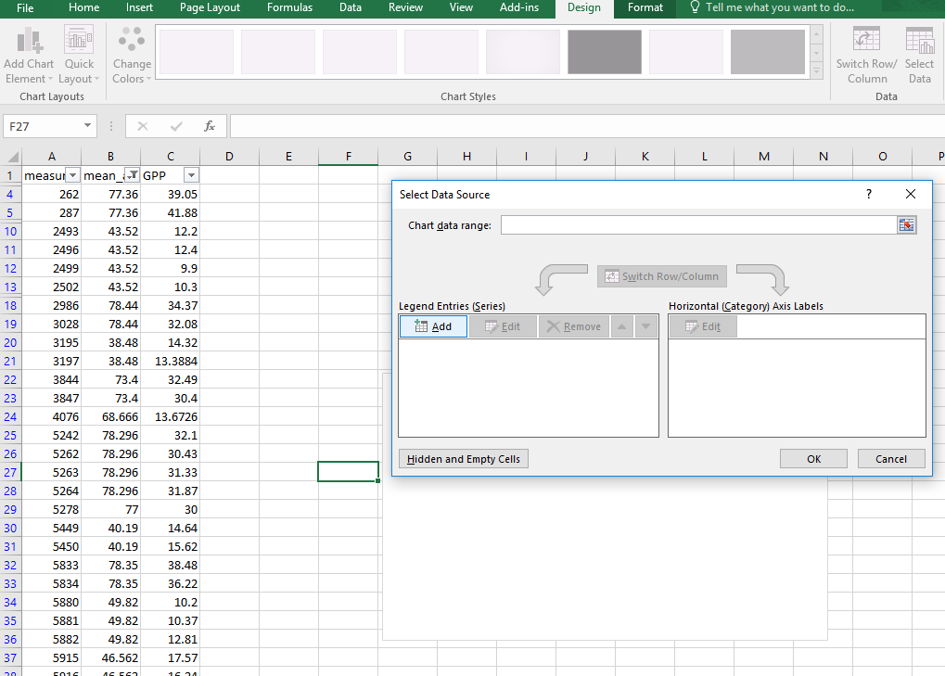
Create a Scatter Plot
Click the “add” tab

Slide 22
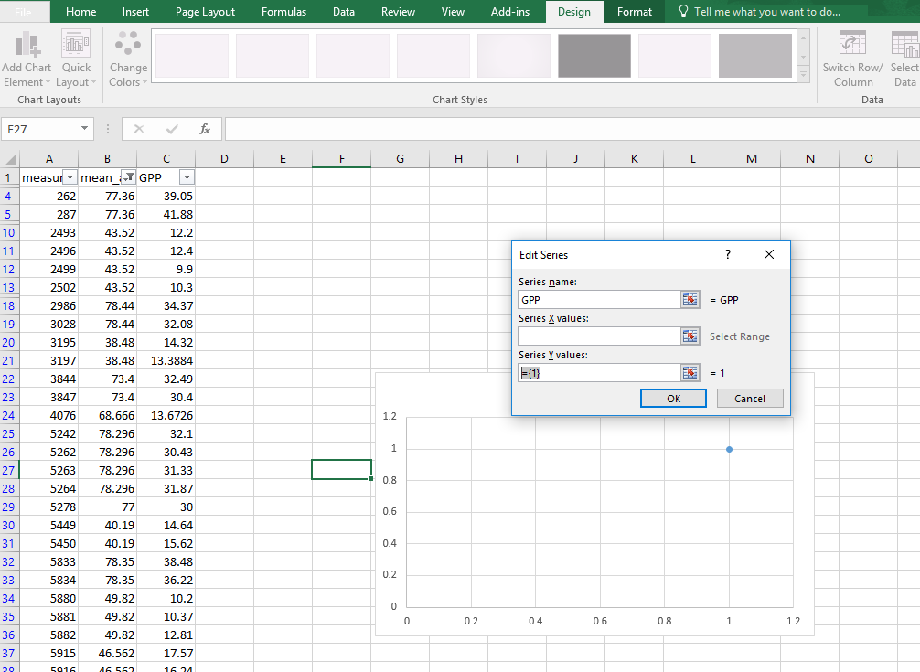
Create a Scatter Plot
Name the series GPP
Delete the series Y values if there is anything there (do not hit enter yet)

Slide 23
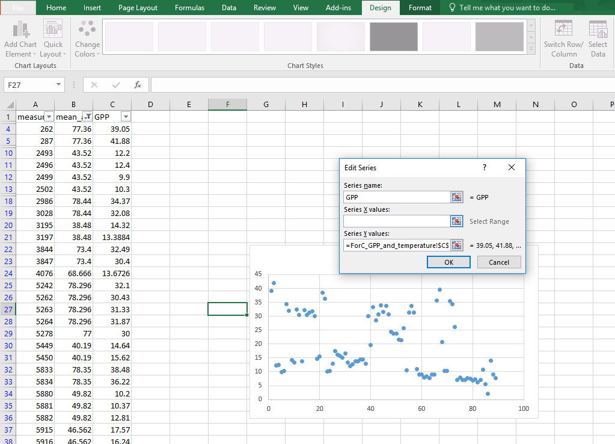
Create a Scatter Plot
Click the first value under GPP and scroll down to select all values in the column.
Next click the blank by the X value series

Slide 24
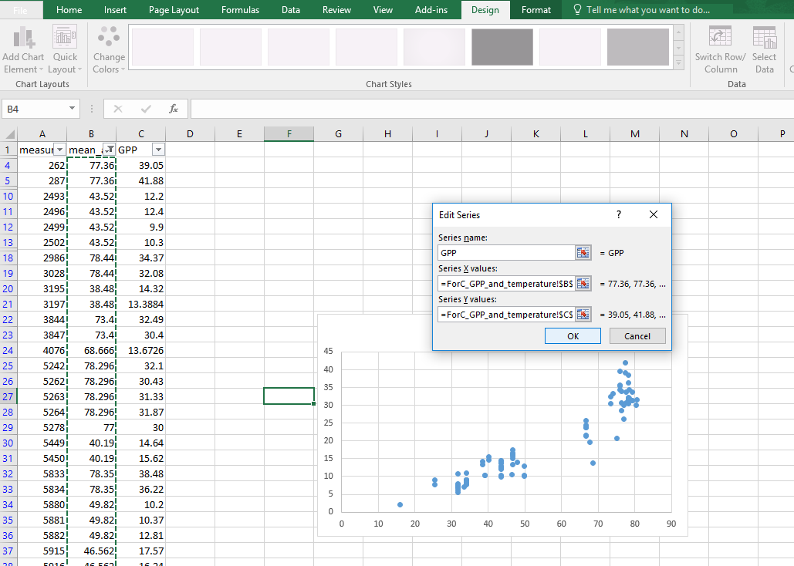
Create a Scatter Plot
High light the mean_temperature column for the X value
Click OK
Then Click OK again

Slide 25
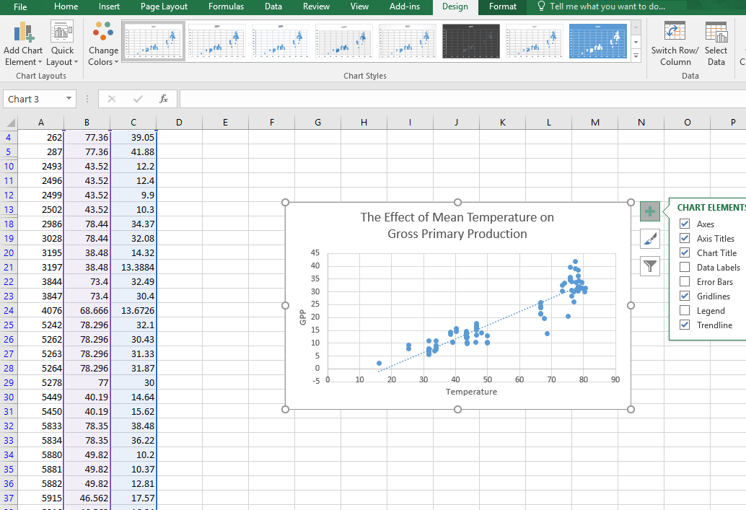
Create a Scatter Plot
Now click the + tab and add Axes, Axes Titles, Chart Title, and a Trendline.
Fill it out as seen here

Slide 26
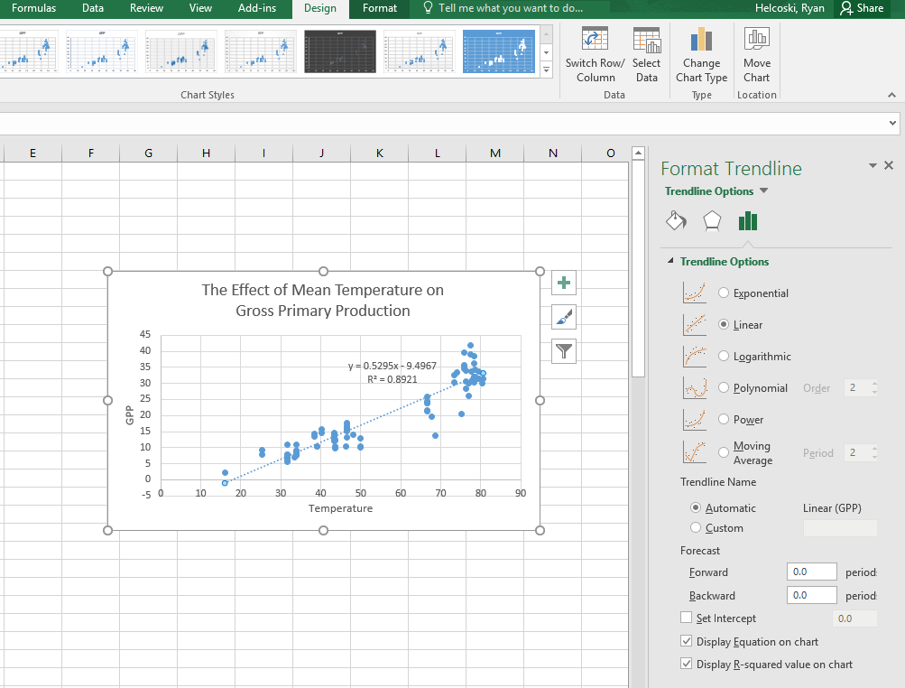
Create a Scatter Plot
Right click the dotted trendline and left click “Format Trendline”
Make sure to click the check for “Display Equation on chart” and “Display R-squared value”

Slide 27
Data Analysis
A linear regression line has an equation of the form Y = a + bX, where X is the independent variable and Y is the dependent variable. The slope of the line is b, and a is the intercept (the value of y when x = 0).
The R squared value is a statistical measure of how close the data are to the fitted regression line.
The R-squared is always between 1 and 0:
0 indicates that the model explains none of the variability of the response data around its mean.
1 indicates that the model explains all the variability of the response data around its mean

Slide 28
Things to remember (while writing your conclusion)
These data are for forests all over the world and the trend you see is real
However, this is not a time series so we can’t use it to make broad statements about the impacts of global warming
Avoid definitive statements such as “we proved,” in science we rely on data and we change our minds based on data. Your analysis doesn’t “prove” anything, but your data do “support” something and you can make some (relatively) secure assumptions based on it
Feel free to get help from others and discuss your work, but avoid plagiarism (plagiarism is an automatic ZERO)

Slide 29

Acknowledgements
Co-authors: Ryan Helcoski, Kristin Black, Kristina Anderson-Teixeira
We would like to thank the following organizations for providing funding to make this endeavor possible

